Slide 1
DEM and CFD Coupling
Lucilla Almeida

Slide 2
Outline
DEM-CFD Coupling Formulation
Validation cases

Slide 3
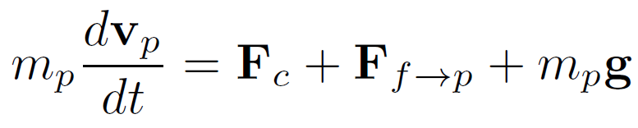
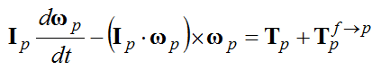
DEM
fluid-particle interaction
particle-particle and particle-wall contact forces
Currently available in Rocky
Euler’s Equations:

Slide 4
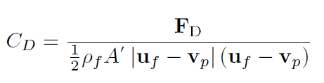
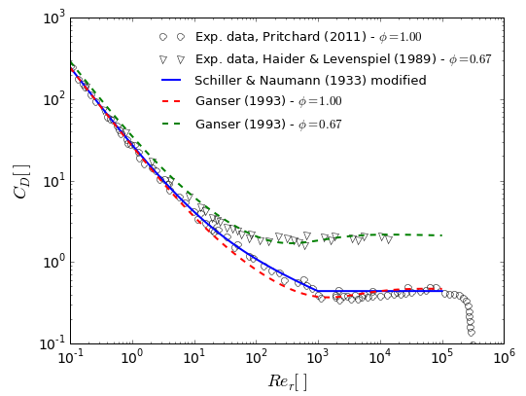
Drag models
Dilute flows
Schiller & Naumann (1933)
DallaValle (1948)
Haider & Levenspiel (1989)
Ganser (1993)
Dense flows
Wen & Yu (1966)
Ergun (1958)
Huilin & Gidaspow (2003)
Di Felice (1994)
Spherical particles
Takes into account shape

Slide 5
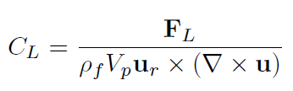
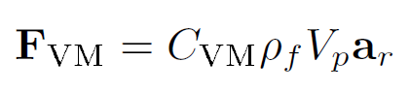
Fluid-particles interaction forces
Virtual mass force
Available virtual mass models:
Constant
Ishii & Mishima (1984)
Paladino (2005)
Lift force
Available lift models:
Saffman (1968)
Mei (1992)

Slide 6
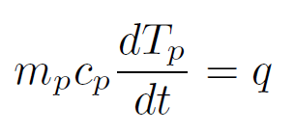
Particle heat transfer
Convective fluid-particle heat transfer
contact heat transfer
Particle heat source
For stardard (lumped) formulation:
For improved (lumped) formulation:
Notes:
A ideia da analise aperfeicoada e prover uma relac~ao melhor entre os potenciais de
contorno e dos potenciais medios, que s~ao desenvolvidos a partir da aproximac~ao
de Hermite para integrais. Esta aproximac~ao permite a express~ao de integrais de
temperatura media e as integrais de uxo de calor pelos valores da temperatura e
do uxo de calor no contorno.

Slide 7
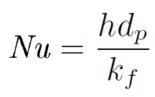
Particle heat transfer
Heat transfer coefficient based on Nusselt number:
Available Nusselt number correlations:
Ranz & Marschall (1952)
Whitaker (1972)
Gunn (1978)
Single particle
Fixed or fluidized beds

Slide 8
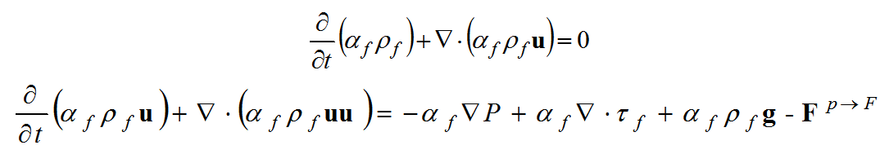
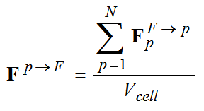
CFD
Influence of particle on the fluid flow is taken into account by the volume fraction and momentum exchange force.
particle-fluid
interaction
Calculated on DEM software

Slide 9
Case 1 – free falling particle
Free falling particle in water
Schiller & Naumann drag correlation

Slide 10
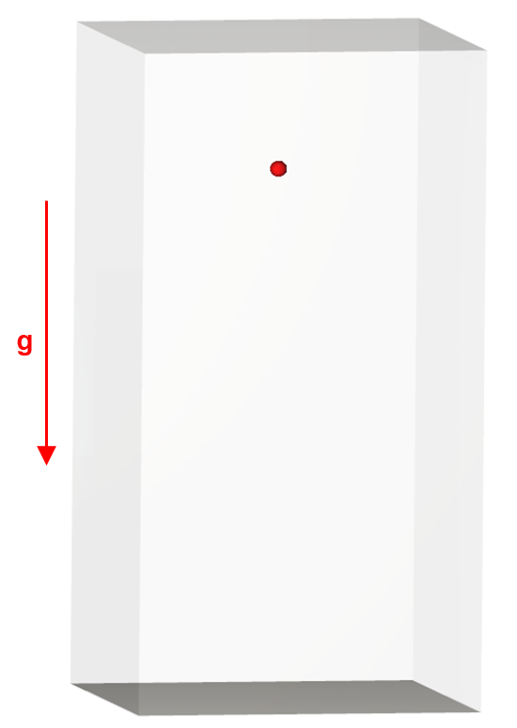
Case 1 – free falling particle
Free falling particle
Laminar flow
 |  | Value | Unit
Domain | Dimensions | 4x8x4 | mm
 | Mesh size | 0.25 | mm
Particle | Diameter | 0.2 | mm
 | Density | 2500 | Kg/m³
Water | Viscosity | 0.001 | Pa.s
 | Density | 1000 | Kg/m³

Slide 11
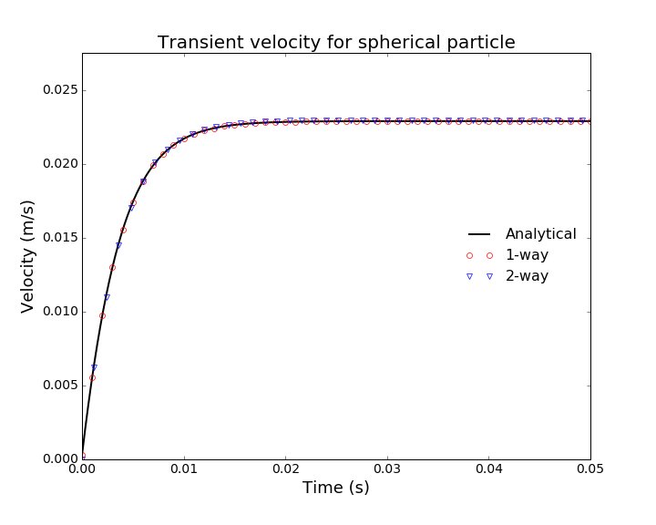
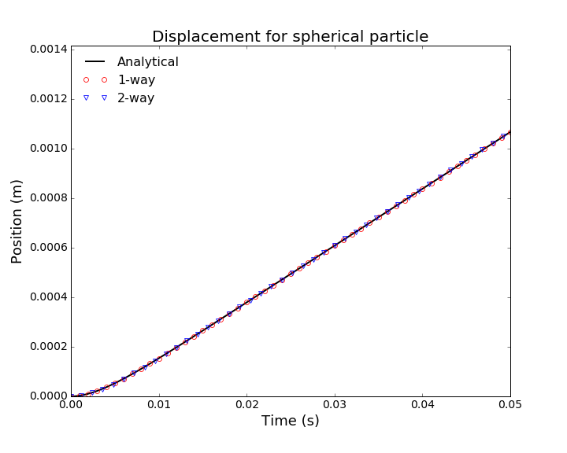
Case 1 – free falling particle
Velocity and position

Slide 12
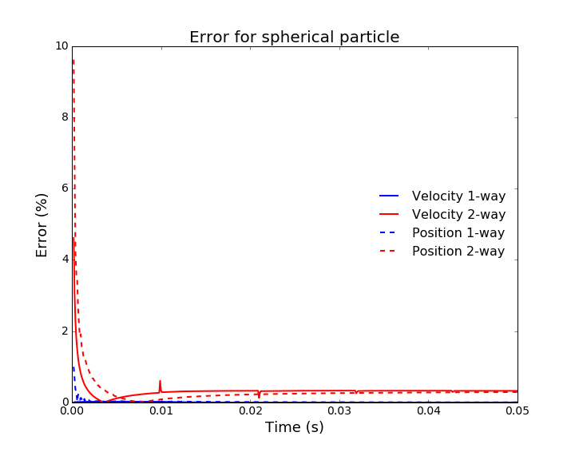
Case 1 – free falling particle
Free falling particle

Slide 13
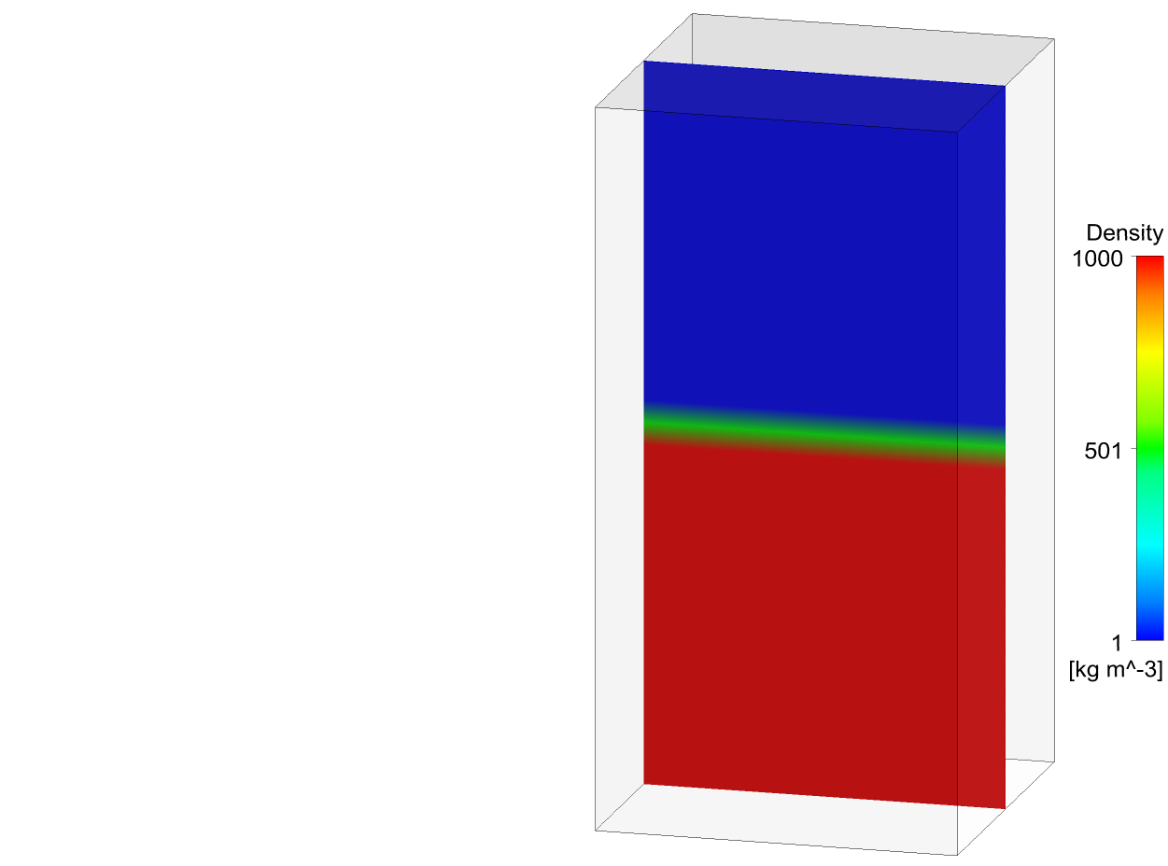
Case 2 – free falling particle in two-fluids domain
Free falling particle in two-fluids domain
 |  | Value | Unit
Domain | Dimensions | 4x8x4 | mm
 | Mesh size | 0.25 | mm
Particle | Diameter | 0.2 | mm
 | Density | 2500 | Kg/m³
Air | Viscosity | 0.00001 | Pa.s
 | Density | 1 | Kg/m³
Water | Viscosity | 0.001 | Pa.s
 | Density | 1000 | Kg/m³

Slide 14
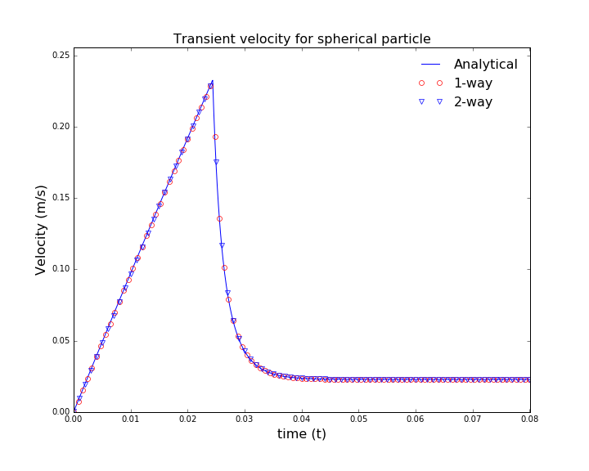
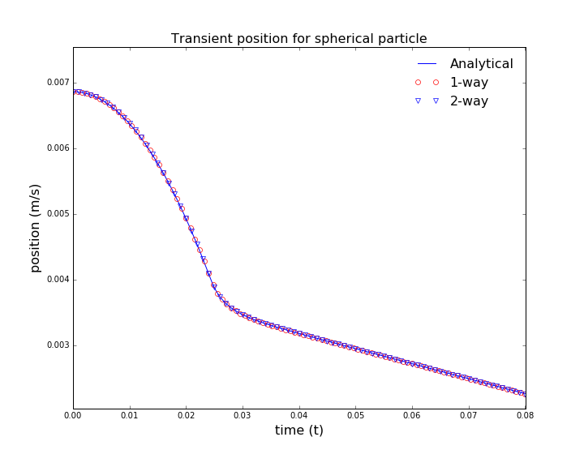
Case 2 – free falling particle in two-fluids domain
Velocity and position

Slide 15
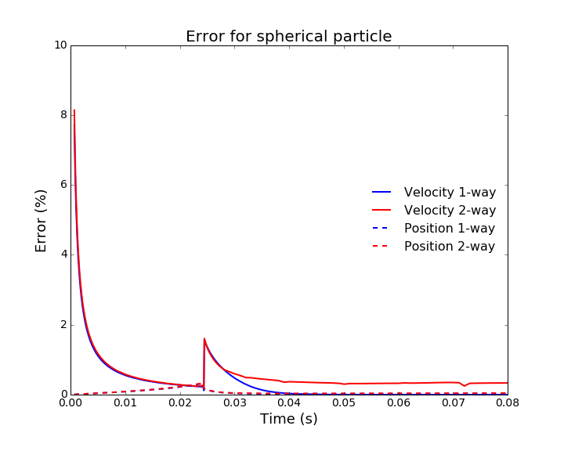
Case 2 – free falling particle in two-fluids domain
Free falling particle

Slide 16
Case 3 – cooling particle with standard formulation
Cooling particle in water
Schiller & Naumann drag correlation
Temperature variation as function of heat exchange with water
Whitaker and Ranz & Marshal correlation for Nusselt number

Slide 17
Case 3 – cooling particle with standard formulation
 |  | Value | Unit
Domain | Dimensions | 4x8x4 | mm
 | Mesh size | 0.25 | mm
Particle | Diameter | 0.2 | mm
 | Density | 2500 | Kg/m³
 | Heat Capacity | 1000 | J/kg.K
 | Thermal conductivity | 100 | W/m.K
 | Initial temperature | 500 | K
Water | Viscosity | 0.001 | Pa.s
 | Density | 1000 | Kg/m³
 | Heat Capacity | 5000 | J/kg.K
 | Thermal conductivity | 0.5 | W/m.K
 | Temperature | 300 | K

Slide 18
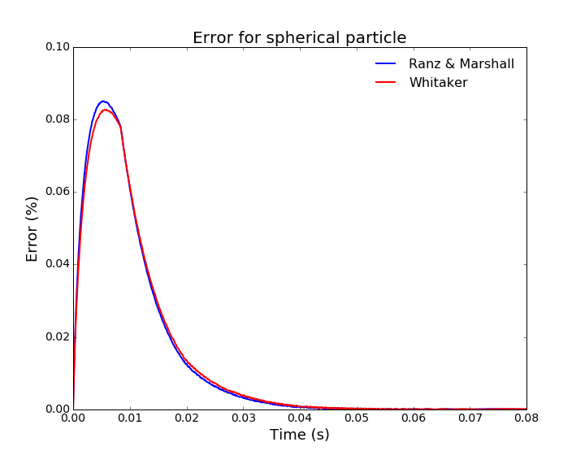
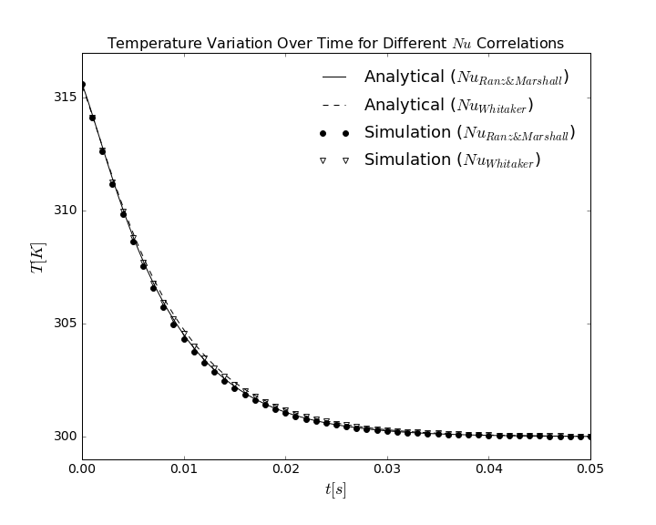
Case 3 – cooling particle with standard formulation
Standard formulation
Thermal conductivity = 100 W/m.K
Bi =0.01

Slide 19
Case 4 – cooling particle with improved formulation
Cooling particle in water
Schiller & Naumann drag correlation
Ranz & Marshal correlation for Nusselt number
Temperature variation as function of heat exchange with water

Slide 20
Case 4 – cooling particle with improved formulation
 |  | Value | Unit
Domain | Dimensions | 4x8x4 | mm
 | Mesh size | 0.25 | mm
Particle | Diameter | 0.2 | mm
 | Density | 2500 | Kg/m³
 | Heat Capacity | 1000 | J/kg.K
 | Thermal conductivity | Case dependent | W/m.K
 | Initial temperature | 500 | K
Water | Viscosity | 0.001 | Pa.s
 | Density | 1000 | Kg/m³
 | Heat Capacity | 5000 | J/kg.K
 | Thermal conductivity | 0.5 | W/m.K
 | Temperature | 300 | K

Slide 21
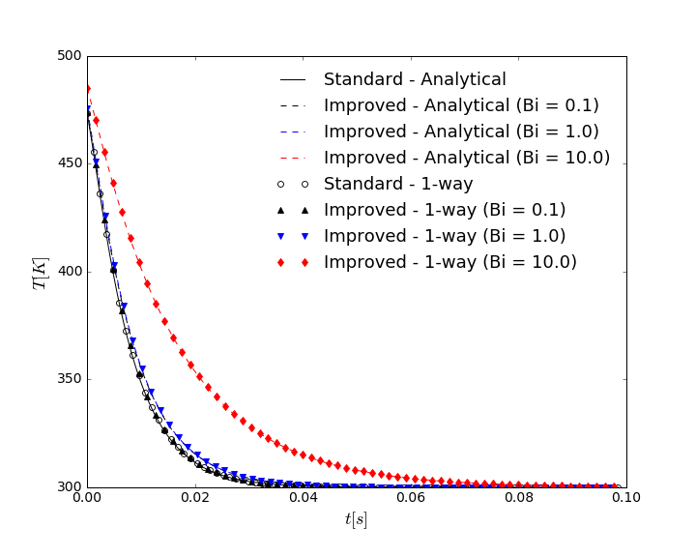
Case 4 – cooling particle with improved formulation
Standard vs. improved formulation
Thermal conductivity modified in order to have different Biot numbers
Bi =0. 1, 1.0 and 10.0

Slide 22
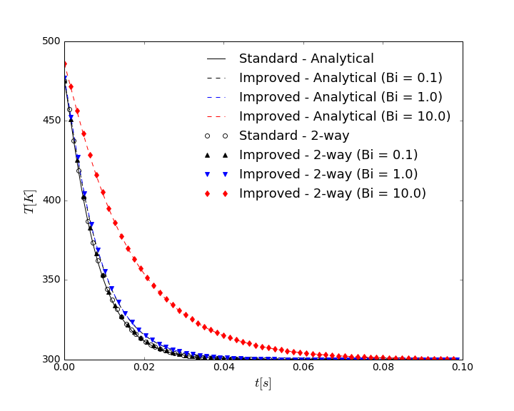
case 4 – cooling particle with improved formulation
Standard vs. improved formulation
Thermal conductivity modified in order to have different Biot numbers
Bi =0. 1, 1.0 and 10.0

Slide 23
Case 5 – falling particle with heat source
Cooling particle with volumetric heat source in water
Schiller & Naumann drag correlation
Ranz & Marshal correlation for Nusselt number
Temperature variation as function of heat exchange with water

Slide 24
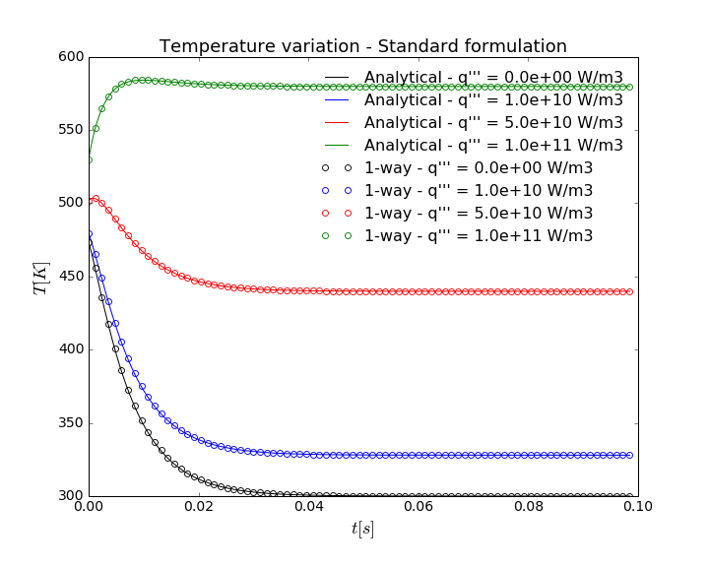
Case 5 – falling particle with heat source
Standard formulation
Three different heat source values

Slide 25
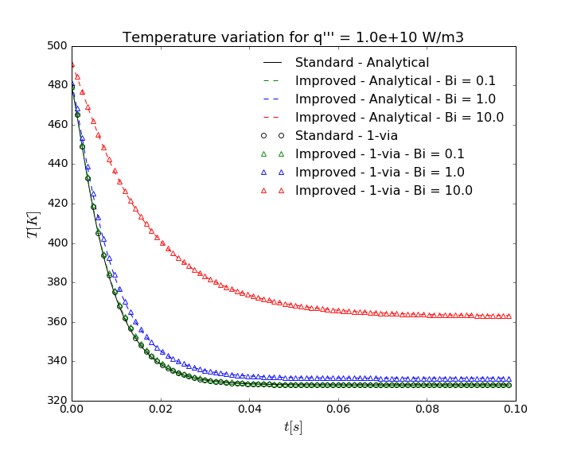
Case 5 – falling particle with heat source
Standard x improved formulation
Thermal conductivity modified in order to have different Biot numbers
Bi =0. 1, 1.0 and 10.0

Slide 26
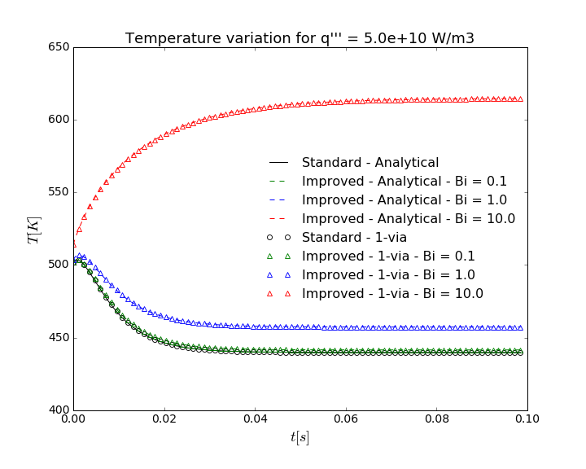
Case 5 – falling particle with heat source
Standard x improved formulation
Thermal conductivity modified in order to have different Biot numbers
Bi =0. 1, 1.0 and 10.0

Slide 27
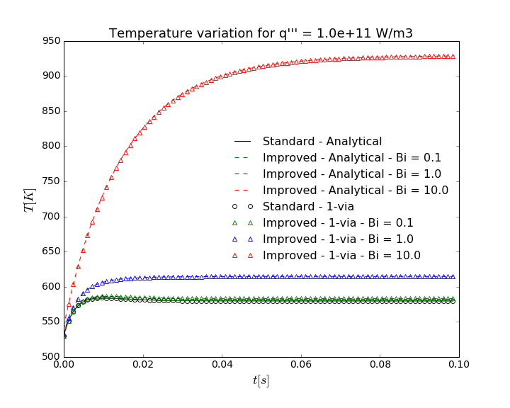
Case 5 – falling particle with heat source
Standard x improved formulation
Thermal conductivity modified in order to have different Biot numbers
Bi =0. 1, 1.0 and 10.0

Slide 28
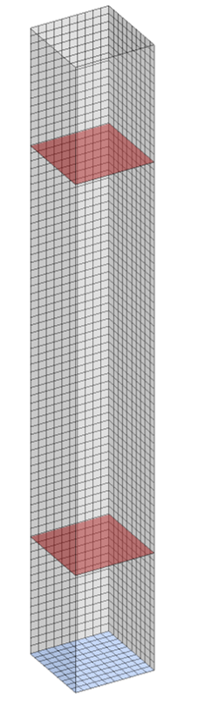
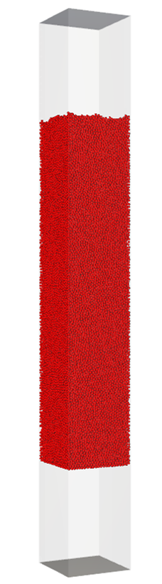
Case 6 – water flowing through fixed bed
Water flowing through fixed bed of particles
Pressure drop comparison against Ergun correlation
Fluid velocity as function of void fraction

Slide 29
Case 6 – water flowing through fixed bed
Huilin & Gidaspow drag corrleation
 |  | Value | Unit
Domain | Dimensions | 10x10x80 | cm
 | Mesh size | 10 | mm
Particle | Diameter | 3.95 | mm
 | Number of particles | 92798 | -
 | Bed height | 0.5 | m
 | Density | 500 | Kg/m³
Water | Viscosity | 0.001 | Pa.s
 | Density | 1000 | Kg/m³

Slide 30
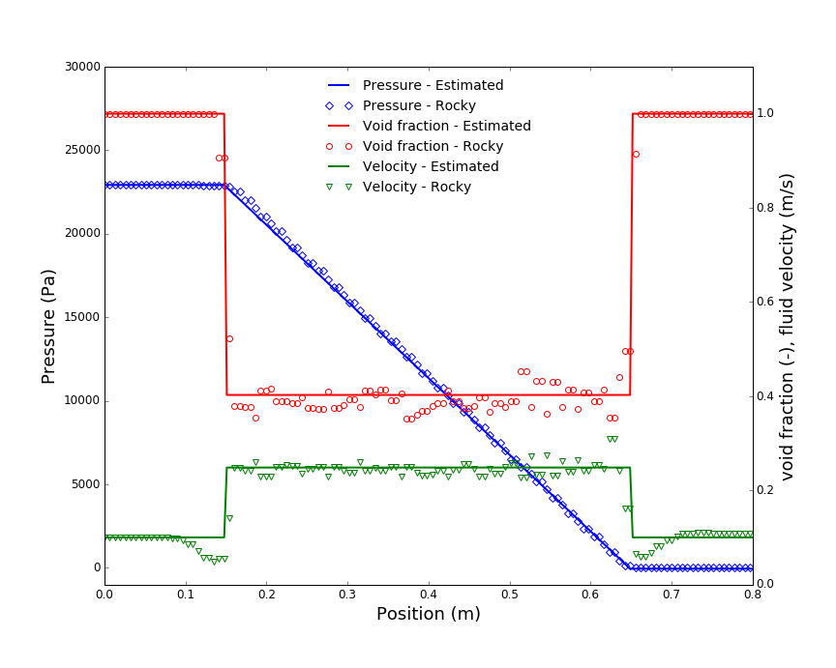
Case 6 – water flowing through fixed bed
Velocity and position

Slide 31
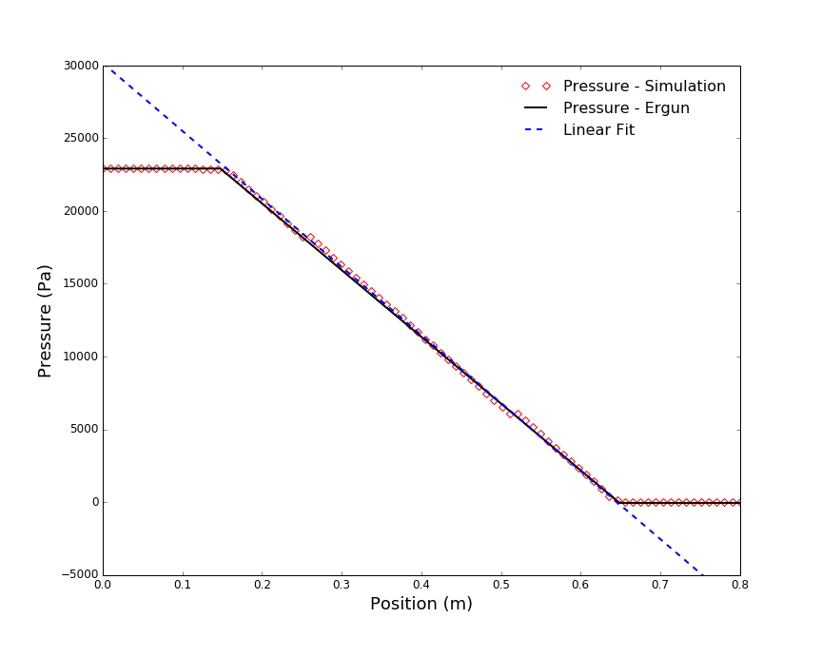
Case 6 – water flowing through fixed bed
Pressure drop in the bed is 46728 Pa/m
Ergun’s correlation estimative is 45836.77 Pa/m
Error is 1.94 %

Slide 32
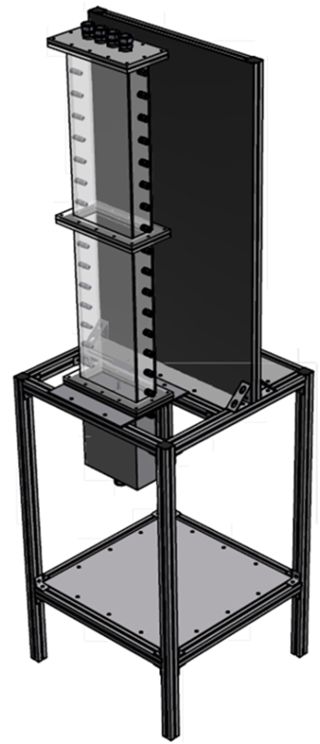
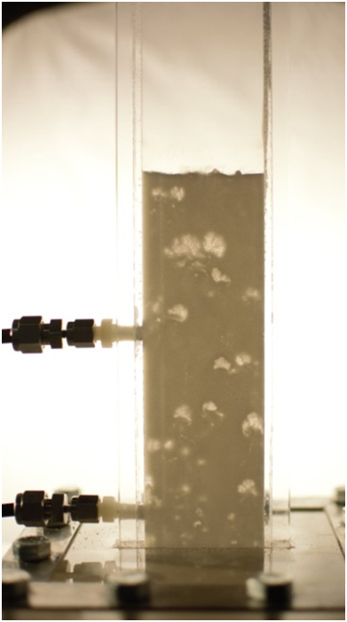
Case 7 – Fluidized bed
NETL small scale tests widely used to improve the reliability of computational modeling of multiphase flows by validating with accurate and well defined experimental data
3 x 9 x 48 in bubbling fluidized bed
Geldart D uniform sized particles
2-way coupling test using dense drag law
(a) SSCP-I test facility and (b) Experimental facility showing pressure intakes
Notes:
This second example one is a standard bubbling fluidized bed with relatively big particles (Geldart D particles).
We have chosen to use National Energy Technology Laboratory experimental data because they are well defined and accurate data, freely available and have been used for the CFD community to validate their codes.
The idea is to use our 2-way coupling using a dense drag law to model this fluidized bed.

Slide 33
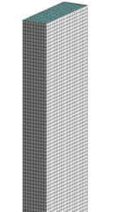
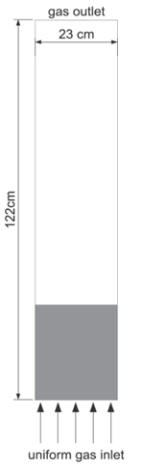
Case 7 – Fluidized bed
Uniform grid
23808 cells
Cell volume = 50 * particle volume
Column with rectangular cross-section
Pressure drop between two intakes
Gas distributor not included
Case | Inlet velocity [m/s]
Small velocity | 2.19
Medium velocity | 3.28
High velocity | 4.38
Notes:
As can be seen, on the CFD side we have a column with rectangular cross-section, uniform grid cells and air enters from the bottom with different velocities. Actually, I’ve gradually increased air velocity from 0 to each final velocity to observe the beginning of the fluidization. Air enters at 10C while particle initially are at 50C.
Additionally two pressure monitors were included so that we could compare pressure drop against experimental data.

Slide 34
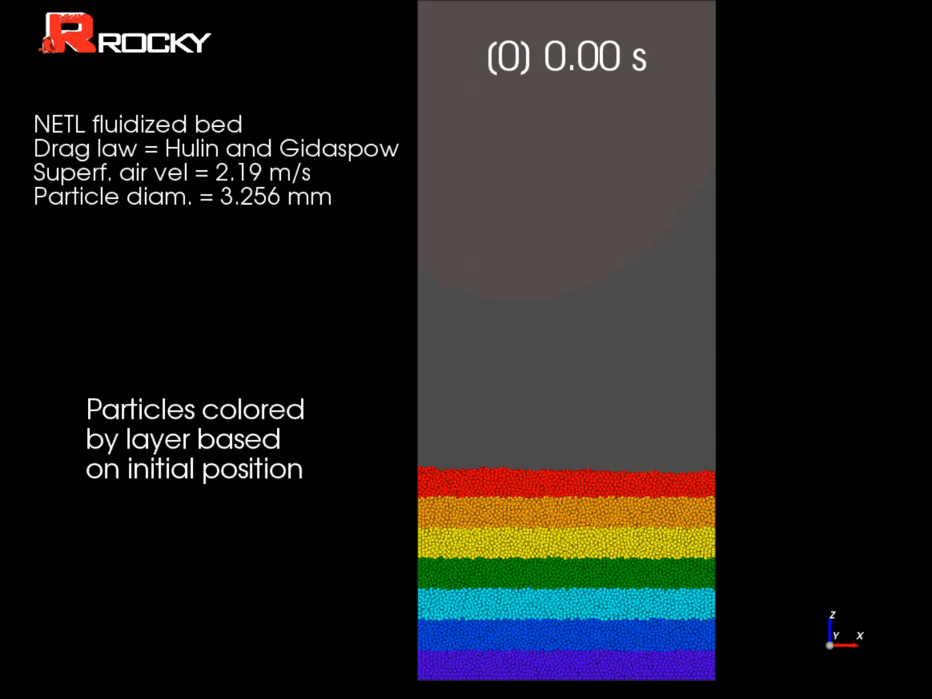
Case 7 – Particles behaviour

Slide 35
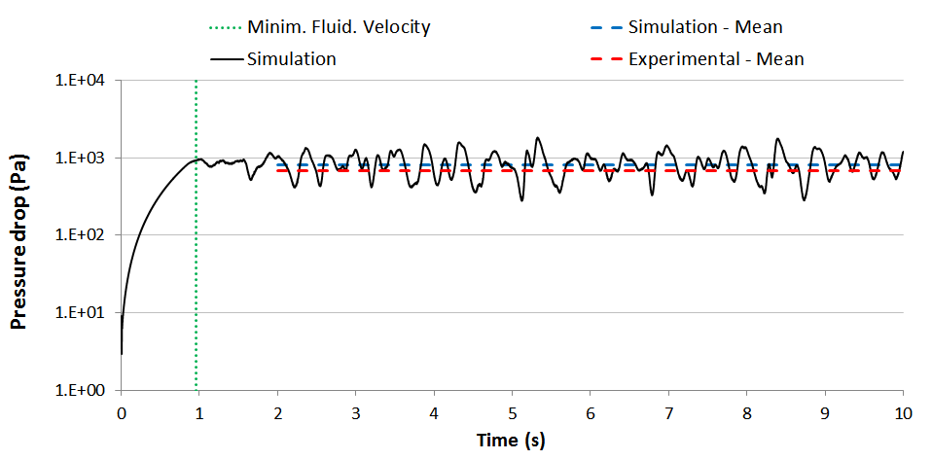
Case 7 - Pressure drop
Experimental and simulation minimum fluidization velocities coincide well.
Good agreement between experimental and simulation pressure drop results after fluidization.
Small velocity case - Evolution of pressure drop between the two pressure intake locations
Notes:
This slide shows the results of pressure drop. You can see that the experimental minimum fluidization velocity (shown by this green dashed line) coincide well with the moment in which fluidization starts in the simulation.
Equally important, there is good agreement between experimental and simulation drop after fluidization has started. It is interesting because shows us that forces on particles are correctly computed for this case.

Slide 36
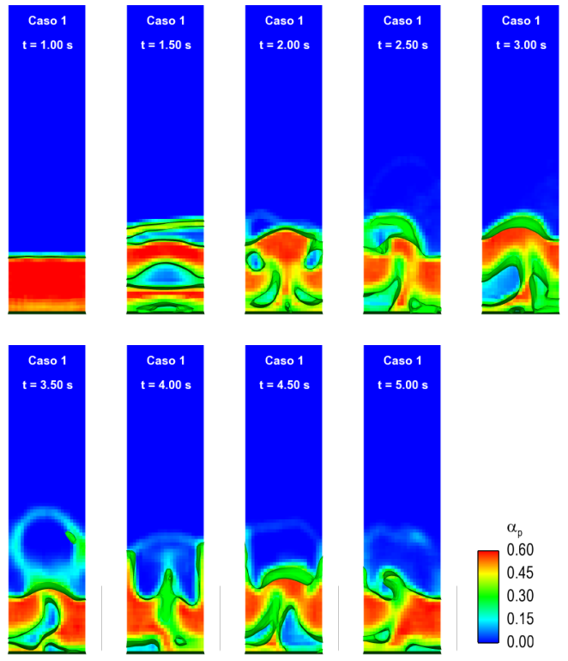
Case 7 – bubble/bed dynamics
Isosurfaces of αp =0.3
Bubbles formation since Umf, as expected for a Geldart D bed
↑ gas velocity
↑ bubble volume
↑ bed height
↓ interface definition
Notes:
This slide shows the bubbles and bed dynamics.
In the left hand sidem isosurfaces of particle volume fraction equal to 0.3 shows bubbles formation since U_{mf}, as expected for a Geldart D bed.
On the right hand side, the height of the bed is plotted for the three cases and the characteristic fluctuation of bubbling fluidized beds is seen.
More than that, we can see that ↑ gas velocity
↑ bed height
↑ fluctuations
Agreement with published results

Slide 37
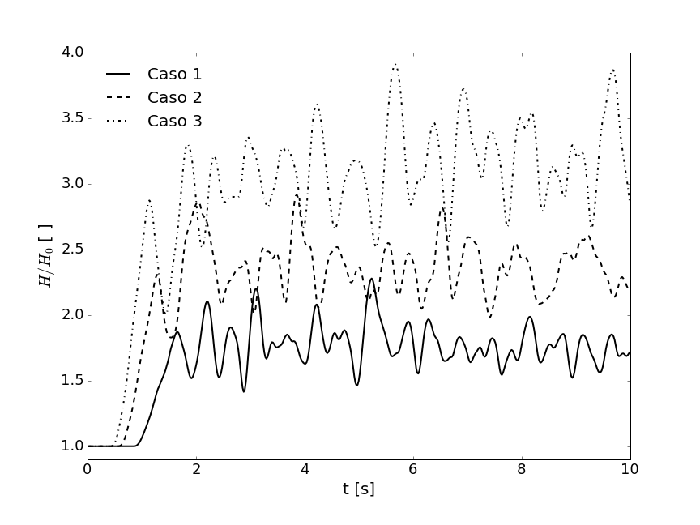
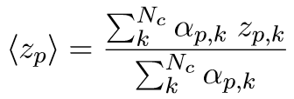
Case 7 – bubble/bed dynamics
Reflects the characteristic fluctuation of bubbling fluidized beds
↑ gas velocity
↑ bed height
↑ fluctuations
Agreement with published results
Time evolution of bed average heights (divided by the initial bed height) for each of the cases
Notes:
This slide shows the bubbles and bed dynamics.
In the left hand sidem isosurfaces of particle volume fraction equal to 0.3 shows bubbles formation since U_{mf}, as expected for a Geldart D bed.
On the right hand side, the height of the bed is plotted for the three cases and the characteristic fluctuation of bubbling fluidized beds is seen.
More than that, we can see that ↑ gas velocity
↑ bed height
↑ fluctuations
Agreement with published results

Slide 38
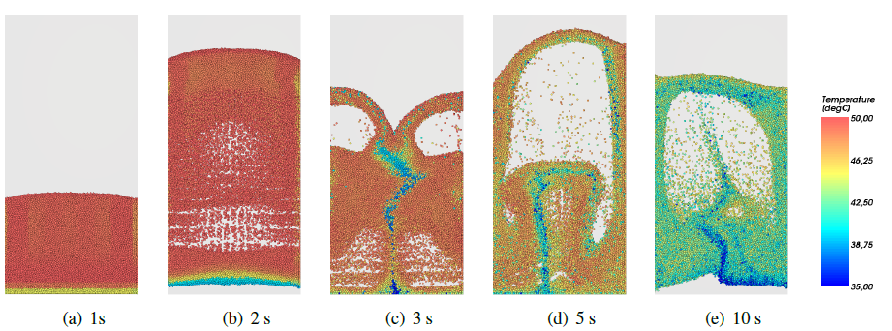
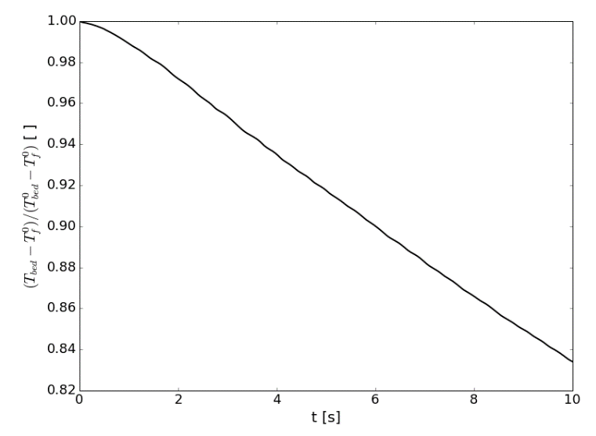
Case 7 – temperature
Before fluidization, particles at initial position (a)
First layers have lower T due to heat transfer with cooler gas (b)
After fluidization, particles at the bottom with lower temperatures go upper (c)
New particles get in contact with cooler gas (d)
Intimate mixing and agitation result in uniform temperature throughout the bed (e)
Notes:
Regarding temperature, Figure shows particles colored by temperature at five different instants.
At the first second of simulation, shown in (a), fluidization is about to start and particles are at the same position they were when the gas started to flow through the bed. It can be seen that the first layers of particles have lower temperature then the remaining bed, due to heat transfer with the flowing gas that enters the bed at 10C. This gas is heated and is not able to transfer heat with particles positioned higher in the bed.
After fluidization process has started, those particles that are in the bottom and have lower temperatures go to upper positions of the bed, as can be seen in (c), and new particles get in contact with the cooler gas entering the bed. This intimate mixing and agitation result in a uniform temperature distribution throughout the bed, as can be seen after a few seconds at (e). the mixing is one of the main advantages of using fluidized beds in industrial processes

Slide 39
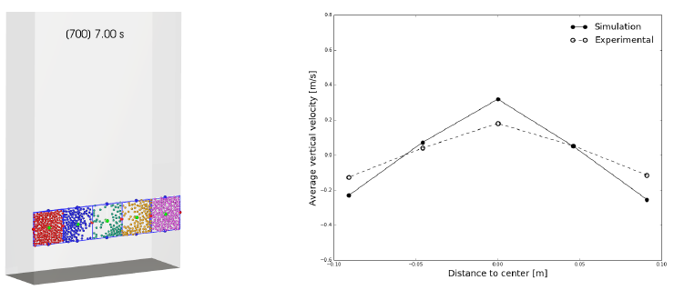
Case 7 – temperature
Dual recirculation pattern was observed.
Same pattern reported in literature.
Average velocity of the particles in 5 different regions of the bed (according to NETL report)
Positive vertical velocity in the central region where the bubbles carry particles upward
Negative values near the walls, where the particles return to ﬁll the empty region.
Notes:
At the first second of simulation, shown in (a), fluidization is about to start and particles are at the same position they were when the gas started to flow through the bed. It can be seen that the first layers of particles have lower temperature then the remaining bed, due to heat transfer with the flowing gas that enters the bed at 10C. This gas is heated and is not able to transfer heat with particles positioned higher in the bed.
After fluidization process has started, those particles that are in the bottom and have lower temperatures go to upper positions of the bed, as can be seen in (c), and new particles get in contact with the cooler gas entering the bed. This intimate mixing and agitation result in a uniform temperature distribution throughout the bed, as can be seen after a few seconds at (e). the mixing is one of the main advantages of using fluidized beds in industrial processes

Slide 40
future developments
Particle scale-down model
Parcel concept
Particle bigger than mesh cell
Notes:
Moving domain + stationary domain with mesh interface
Use parcel concept, in which a group of original particles is simulated using a large-sized particle, named a coarse grain particle, while the drag and non-drag forces are based on the original particle size, what makes it feasible to perform large scale DEM simulations by using a smaller number of particles than the actual number

